Slide 1
Cubesat solar panels
May15-12
Client: John Carr, NASA
Advisor: Gary Tuttle

Slide 2
Member Contributions
Luke Dahlman -Team Leader
Organizes/conducts meetings, emails, & group documents
Antjuan Buffett-Team Intermediary
Acts as a link between members in order to try to bring about an agreement or reconciliation
Tom Henry – Webmaster
Designed and updates group website
Gathers group work for public posting
Anh Ho, Dustin Pierce - Key Concept Holders
Helps group to understand their common objectives and assists in planning how to achieve these objectives
Ryan Bissett, Isaac Johns -Team Communicators
Writes group reports based on group’s previous week’s work
Gathers individual contributions
Notes:
Should this be moved to the beginning

Slide 3
Preliminary Problem Statement
Our group is tasked with designing and implementing a deployable and retractable boom that fits inside a 1 cubic foot satellite used to deploy and retract a solar cell array with a minimum area of 9ft².

Slide 4
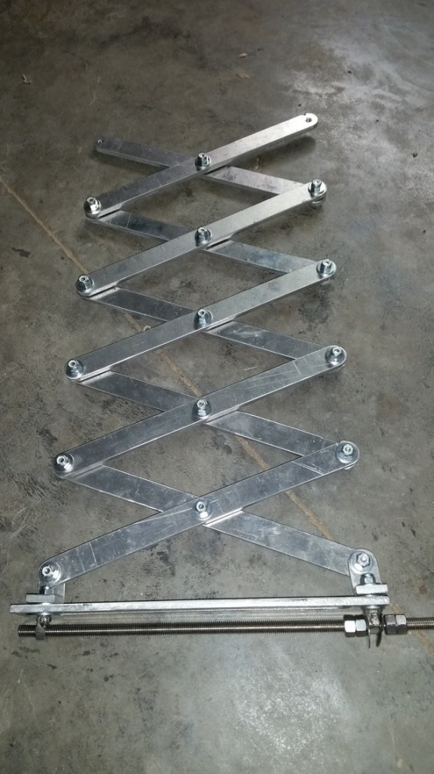
Preliminary Designs-Scissor Jack
Size Constraint
  1ft³ cube
  4-9ft² solar panels
Scissor Design
  Motor
    3 ft-lb
    2 phase motor deploy and retract
    Stepper motor
  Power Transmission
    Screw drive
Notes:
How was 3 ft-lbs

Slide 5
Problem Statement
Our group is tasked with designing and implementing a deployable and retractable boom that fits inside a CubeSat (10cm x 10cm x 10cm) used to deploy and retract a solar cell array with a minimum area of 4ft² using bendable solar arrays.

Slide 6


Preliminary Designs-Fan
One dual phase motor
One servo motor
Difficult to reach 9 ft² solar panels
Gear Drive
  At pivot point - 360° rotation
  One to unfold – achieve more than 1 foot radius
The Area of this method will never achieve 100% full of solar cells
  25mm bending radius
  A_{cell,min} = 1cm x 1cm
Solar Panel Calculation.
$$A=πR^{2}$$
$$R=\frac{4ft^{2}}{π}$$
Notes:
Servo – Position control, require a control signal.
DC motor – using pulse width modulation (PWM)

Slide 7
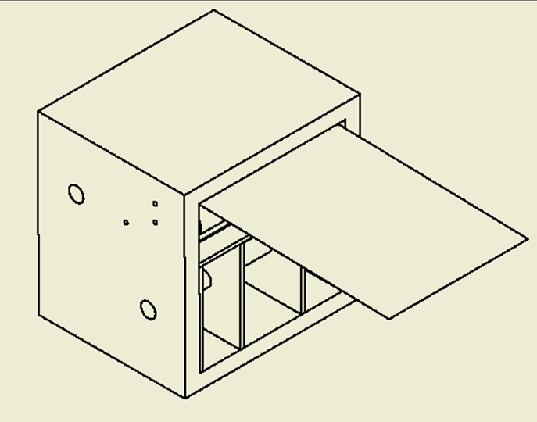
Preliminary Design-Tape Measure
Measure tape technique
  Motor
    <100 oz-inch
    Brushed motor
    Single phase motor deploy
    Continuous
  Power Transmission
    Spur Gears deploy
    Retract – spiral coil
Size Constraint
  1000cm³ cube-sat
  4-9ft² solar panels
Notes:
Brushed vs Brushless:
Brushed – low cost, small enough to use in the cubesat
If the cube-sat is bigger – suggest to use brushless, due to low maintenance, avoid corrosion overtime.

Slide 8
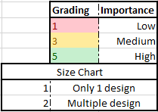
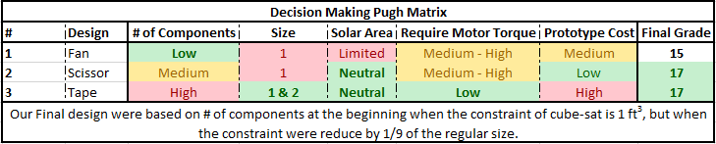
Final Design Decision

Slide 9
Functional Requirements
Repeatable operation.
Low power consumption.
Structural rigidity when extended.
Physical Limitations of Materials
Receive and interpret the signal.
Execute the command while monitoring boom tension.
Latch at full extension.

Slide 10
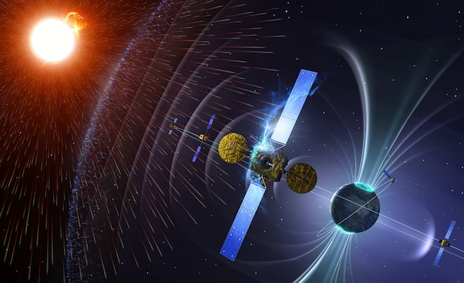
Non-Functional Requirements
Temperature
Radiation
Elasticity
Reliability/Lifetime
Fixed components
Weight
Size
Notes:
Temperatures in Low Earth Orbit can range from -250°F(-157°C) to 250°F(121°C)
Radiation can range from 100-10,000 rad(Si)/year depending on inclination in orbit
The spring should apply enough tension to keep solar array taut without compromising solar array integrity
Ensured by following non-/functional requirements
We need fixed components for vibrational considerations as well as vacuum conditions so that our parts remain in their initial positions.
Weight of each component needs to be considered due to transportation.

Slide 11
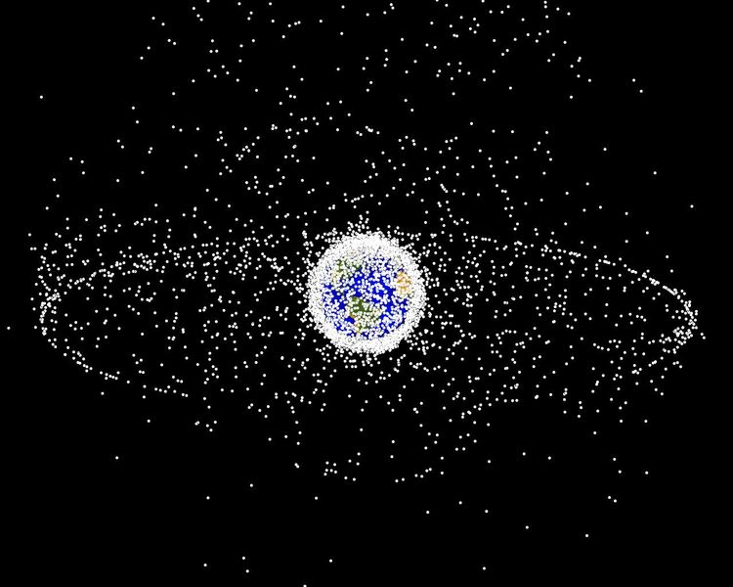
Potential Risks
In Low Earth Orbit (LEO), the primary risks are:
  Temperature swings (-250F to +250F)
  Radiation exposure
  UV exposure
  Extremely low pressure (Vacuum )
  Near zero ease of access
  High-velocity impacts from space debris

Slide 12
Market for CubeSats
Comparable Cost: $10,000
Purpose: Space Research
Users
  NASA, Client
  Universities
  Private Corporations
Notes:
Provide specific examples of what has been learned from cube sats

Slide 13
Material Costs
Total Cost without PLC: $368.46
Notes:
Explain these are costs for our non-space rated mock-up
Make this table “fit” the page better

Slide 14
Technology Platform
Hardware
Atmel Rad-Hard PLC
Motor
Motor controller
Relays
Sensors
Solar array
Software
VHDL
A2D conversion
Power Jack
6V Regulator
3.3V Regulator
Locking Solenoid
Altera Cyclone ii Programmable Logic Controller
Motor Controller
Forward/Reverse Bias Motor
Stop Sensors
Human Interface

Slide 15
Implementing Prototype
Each individual member researched & selected at least one component of the final design
For each component members were asked to create a test for functionality
Individual Components to be Tested
Programmable Logic Controller Solenoids Motor Bearings | Microcontroller Wheels Springs Tape
Notes:
Implementing the prototype this semester means that we conduct the tests we wrote up for each component
Examples
Digital logic for PLC has been tested on the Altera Cyclone II FPGA
Solenoid has been bench-tested and found that 3 V is required to make connection
Motor will be bench-tested by measuring voltage constants, terminal resistance, & torque
Silicone rubber wheels will be tested for static & kinetic friction tested dry against a sled with a calibrated load

Slide 16
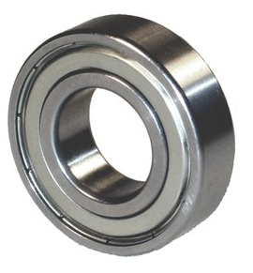
Bearings
Prototype
  Fastenal
  30-35% Greased
Space Implementation
  Timken
Design, Structure and Testing
Lubrication
  Prototype
  NASA test and usage

Slide 17
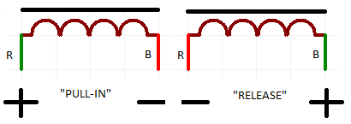
Solenoids
General
Used to latch boom
Reduce power consumption
Testing
Magnetic Latching System
Stays in position when voltage is removed.
  Held out by spring.
  Held in by magnet.
Reverse voltage to move core in other direction.
“Zero-Power-to-Hold”

Slide 18
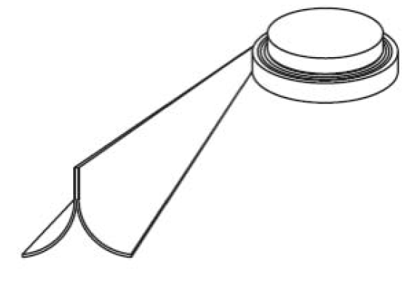
Tape Measure Boom
TRAC Boom
  AFRL
  Nanosail-D
Elgoloy Stainless Steel
Tape Measure Design
Guide Plate
Test

Slide 19
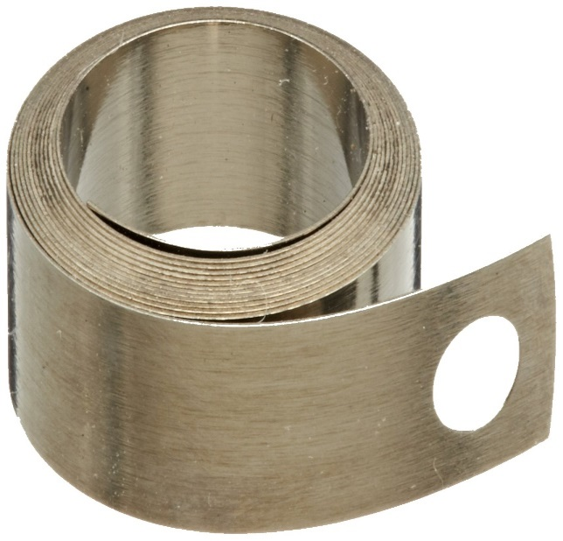
Constant Force Spring
The spring we will use can be found here.
This spring is:
  Compact
  Correctly tensioned
  Low cost.
  Spaceworthy
For NASA’s actual use
  Vulcan Spring’s products recommended

Slide 20
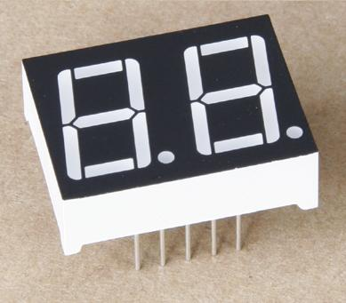
Human to Machine Interface
Test Requirement
Simplified Design
Three Switches, Two Pole
  Stop
  Send Out
  Send In
Seven Segment Display
Notes:
What voltave does this run at.

Slide 21
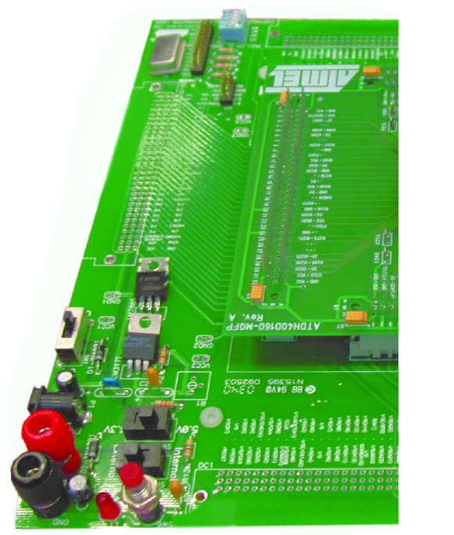
Programmable Logic Controller
ALTERA Cyclone II Test
  Reprogrammable
  Quartus II VHDL
AT40KEL040
  Rad Hard
  233 I/O Pins
  ATMEL FPGA Designer®
3.3V Supply
MIL STD 883 Method 1019

Slide 22
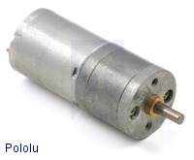
Motor
Brushed DC motor with gearbox
57 rpm
Small size
260 oz·in stall torque
Terminal resistance and torque testing

Slide 23
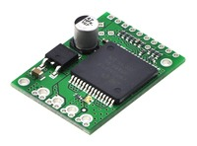
Motor Driver
Operates at 6V delivering continuous 12 A
Various built in shutdowns and protections
Compact Size
Test current sense ability and motor indicator LEDs

Slide 24
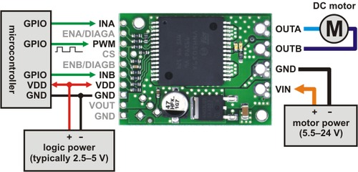
Electrical Interface
172:1 Gearmotor with 260 oz-in stall torque
Motor Driver
Atmel Microcontroller
Notes:
Is this rad hard. How will we ensure this will work

Slide 25
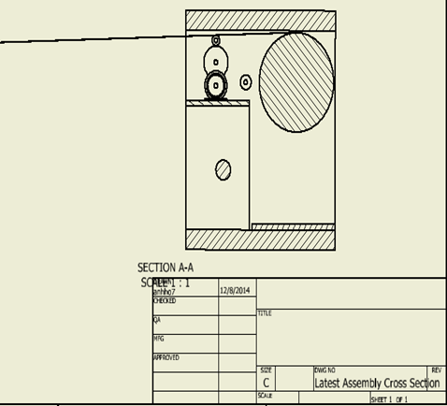
Zoom-in side View
Solar Panels
Connection of the Panels & tape
Free Roller
Solar Panel Roller
Measure Tape
Roller Gear Driven

Slide 26
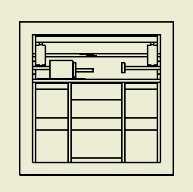
Zoom-in front view
Solar Panel
Free Rotating Roller
Tape
Gear Drive Roller

Slide 27
Project Milestones and Schedule
Analog or Digital 10/05/2014
Circuit Outlines and Improvements 10/31/2014
Our Design Constraints were changed 11/01/2014
Redesigned our 1U CubeSat 11/12/2014
Final Circuit Completion 11/26/2014
Material Selections 12/05/2014
Draft Design Sent to NASA 12/06/2015
Bill Of Materials 12/07/2014

Slide 28
Plan for next semester
Material Ordering 12/19/2014
Circuit Assembled 02/02/2015
Complete Local testing 02/06/2015
Complete all Testing 02/20/2015
Ship prototype to NASA 02/20/2015

